Slide 1
Train Booking System

Slide 2
User Registration Flow
REGISTRATION
username:
Aditya
Registration.java
gender:
Male
database
email:
xyz@gmail
if(valid)
{
Status = “success”
Goto “registration.jsp”;
}
Else
{
Status = “failed”;
Goto “registration.jsp”;
}
aditya@gmail.com
/register
password:
123
*****
Confirm password:
123
*****
Contact number:
0987654321
registration.jsp
1234567890
SUBMIT

Slide 3
User Login Flow
Login.jsp
Login.java
/login
email:
aditya@gmail.com
if(valid)
{
Status = “success”;
Goto “booking.jsp”;
}
Else
{
Status = “failed”;
Goto “login.jsp
}
database
Password:
*****
login.jsp
Login

Slide 4
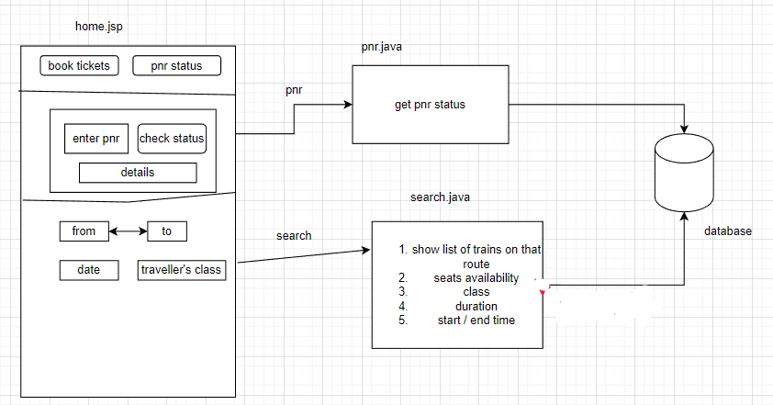
User Landing Page

Slide 5
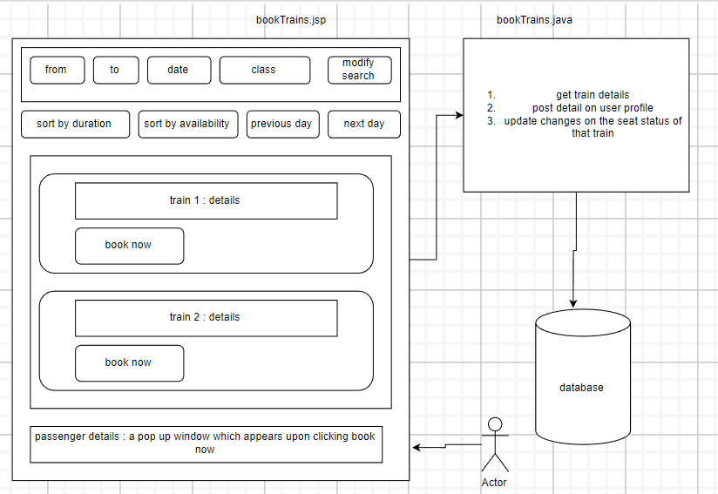
Booking Page (to be accessed after login)

Slide 6
User Profile Page
profil.jsp
profil.java
name:
Aditya
Get detail
From user table
Where
UID = email
Database
email:
aditya@gmail.com
phone:
1234567890
gender:
Male

Slide 7
User Booking History Page
BookingHistory.Jsp
BookingHistory.java
bookingHistory.jsp
B1
cancel
Database
Cancel the selected booking
B2
/booking
B3

Slide 8
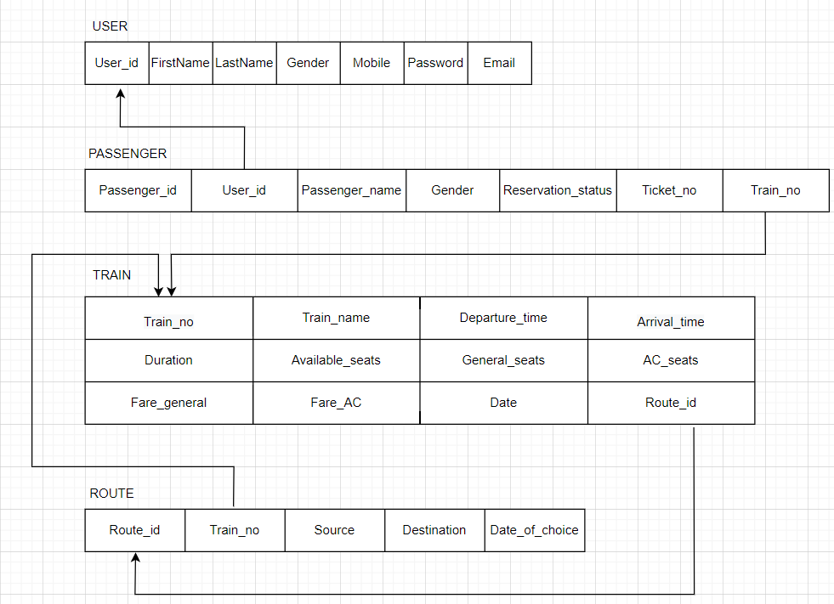
Schema Diagram

Slide 9
Thank You !

